Slide 1
INTRODUCTION TO HEXADECIMAL

Slide 2
Three Number Systems
Binary (Base 2)
  Represented as:
    0,1
    False, True
    Clockwise, Counterclockwise
    Pit, Landing
Decimal (Base 10)
  Represented as
    Figures 0,1,2,3,4,5,6,7,8,9
Hexadecimal (Base16)
  Represented as
    Figures 0,1,2,3,4,5,6,7,8,9,A,B,C,D,E,F

Slide 3
Binary | Decimal | Hexadecimal
00000000 | 0 | 0
00000001 | 1 | 1
00000010 | 2 | 2
00000011 | 3 | 3
00000100 | 4 | 4
00000101 | 5 | 5
00000110 | 6 | 6
00000111 | 7 | 7
00001000 | 8 | 8
00001001 | 9 | 9
00001010 | 10 | A
00001011 | 11 | B
00001100 | 12 | C
00001101 | 13 | D
00001110 | 14 | E
00001111 | 15 | F
00010000 | 16 | 10
00010001 | 17 | 11
Examples of Larger Numbers:
Binary | Decimal | Hexadecimal
00010111 | 23 | 17
01111111 | 127 | 7F
 | 231
 | 189
11010010
01110101
 |  | D2
 |  | E7
 |  | FF
 |  | 20

Slide 4
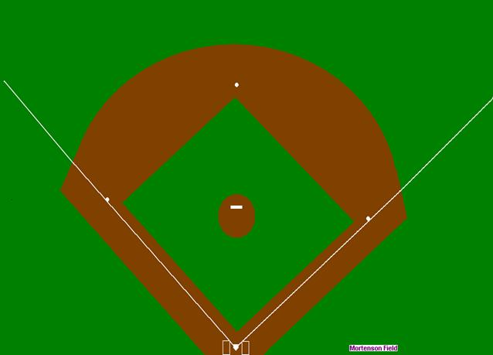
Simple Compression Algorithm for Images
An image of a baseball field is primarily green. One solid green pixel is represented in storage with three bytes:
Pixels: 1920 columns X 1080 rows
Red | Green | Blue
00000000 | 11111111 | 00000000
Uncompressed, the image would be stored in: 1920 X 1080 X 3 = 6,220,800 bytes.
The first row of all green would be
1920 X 3 = 5,760 bytes.
Adding a two-byte length component, the first row of all green can be compressed to 5 bytes!
Length |  | Red | Green | Blue
00001111 | 00000000 | 00000000 | 11111111 | 00000000

Slide 5

ASCII Table - http://ascii-table.com/

Slide 6
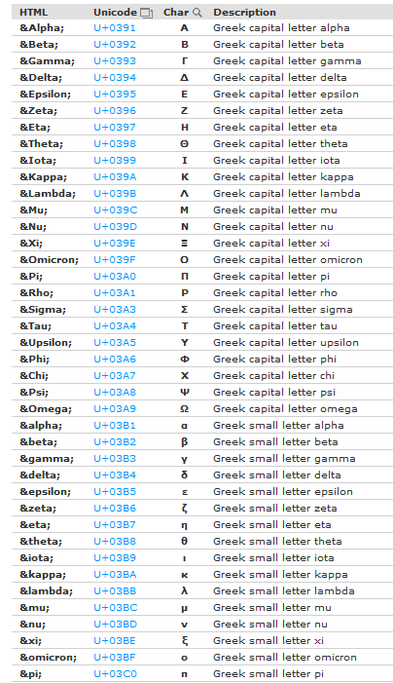
Sample Unicode Table
Full Unicode Table is here: http://ascii-table.com/html-table.php

